Slide 1


Team 6: Scarlet Delivery
Intro to Marketing Spring ’25
Professor Bernstein
Final Team Project

Slide 2
Table of Contents
I. Team Introductions
II. Executive Summary - Yonathan
III. Situation Analysis - Stella
IV. Industry Analysis - Luke
V. Competitive Analysis - Wesley
VI. Environmental Analysis (SWOT) - Jacob
VII. Target Audience(s)/Personas - Yonathan
VIII. Marketing Objectives/Goals - Katelyn
IX. Marketing Mix Strategies - William and Yeison
X. Evaluation & Control - Yeison

Slide 3
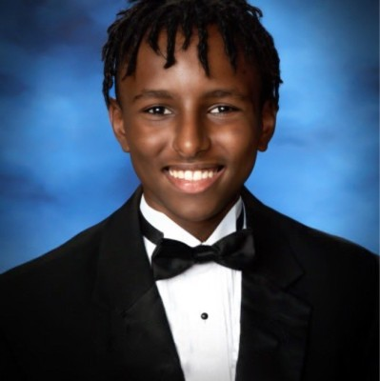
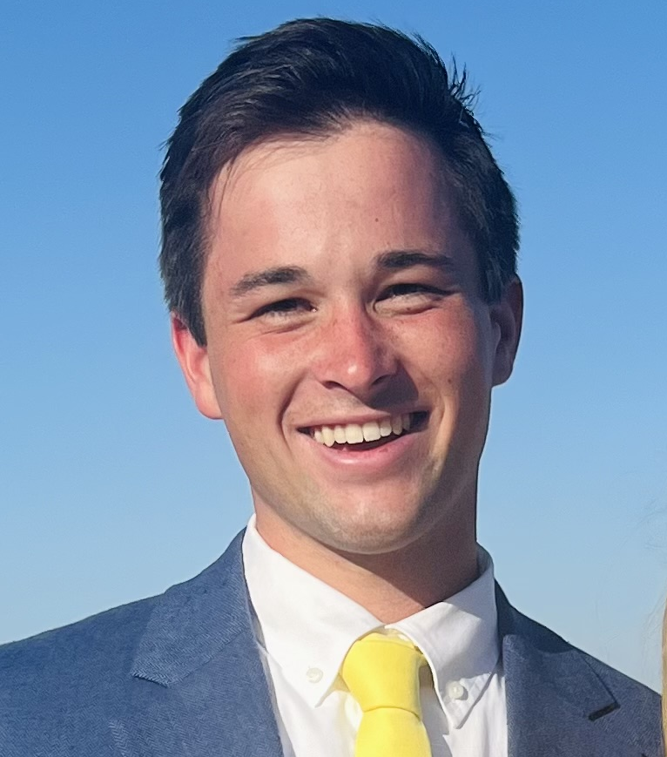
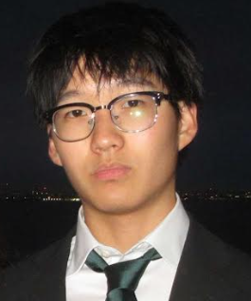
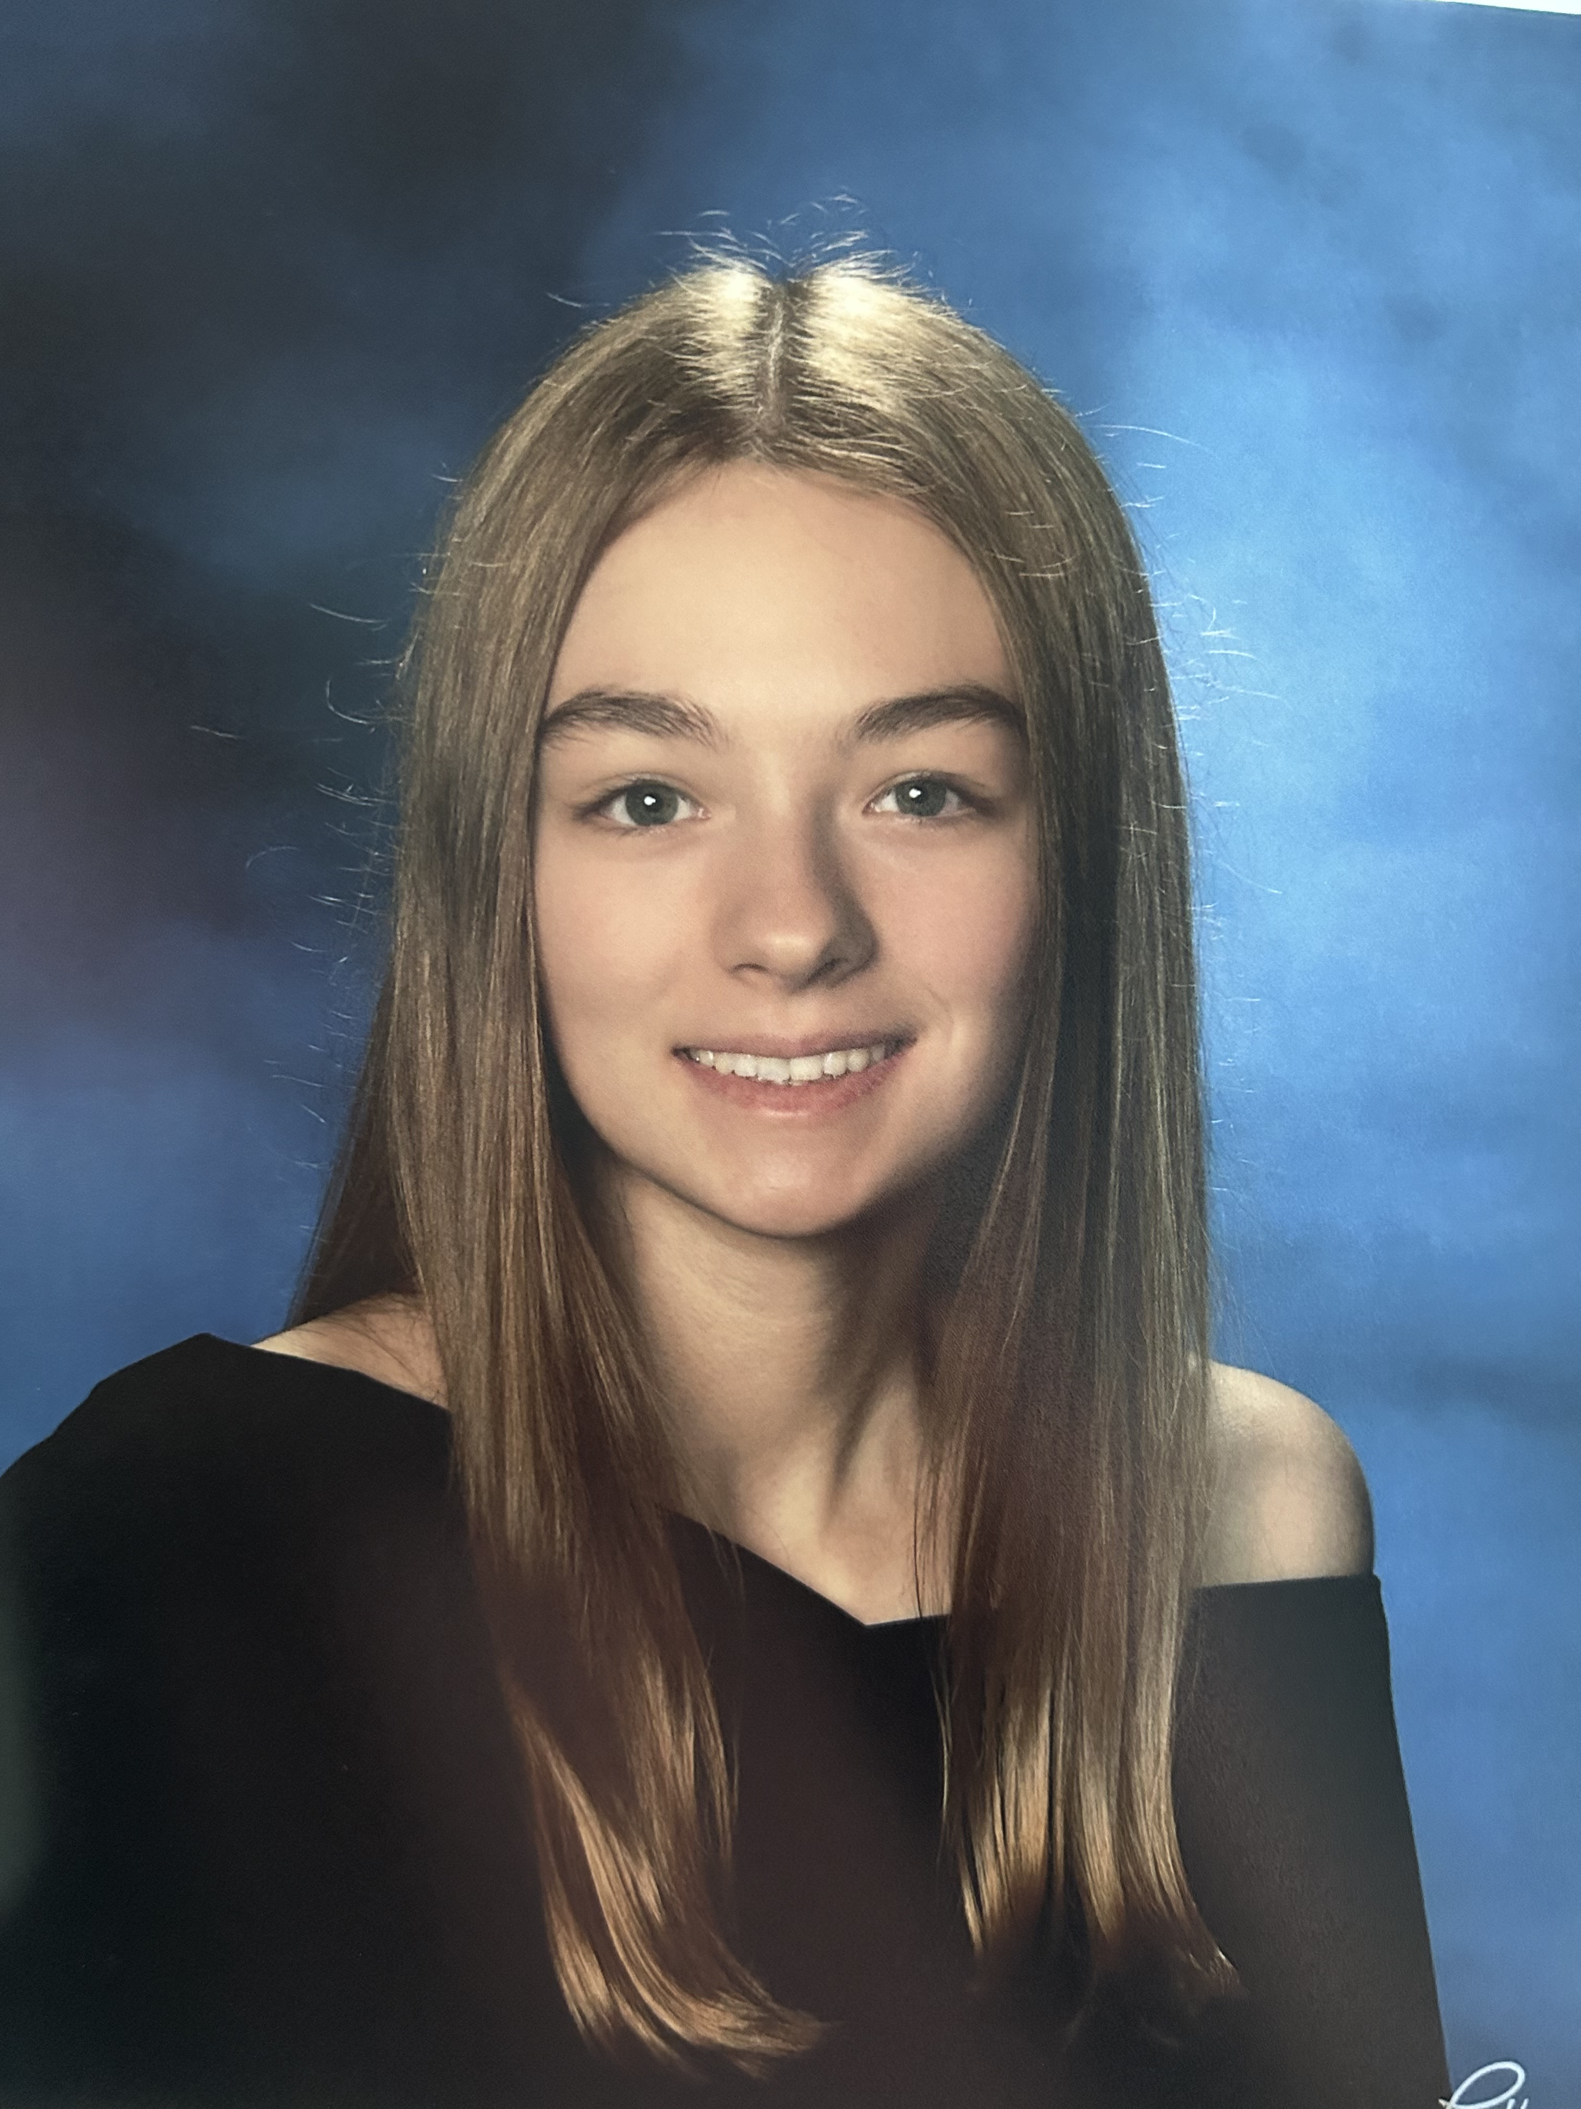

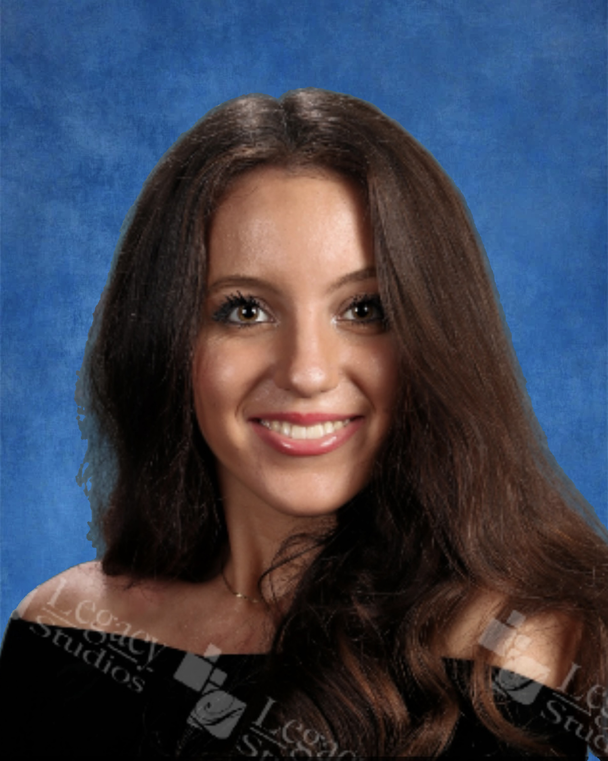
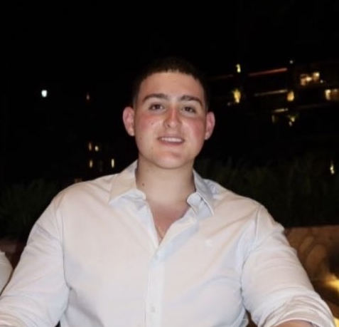
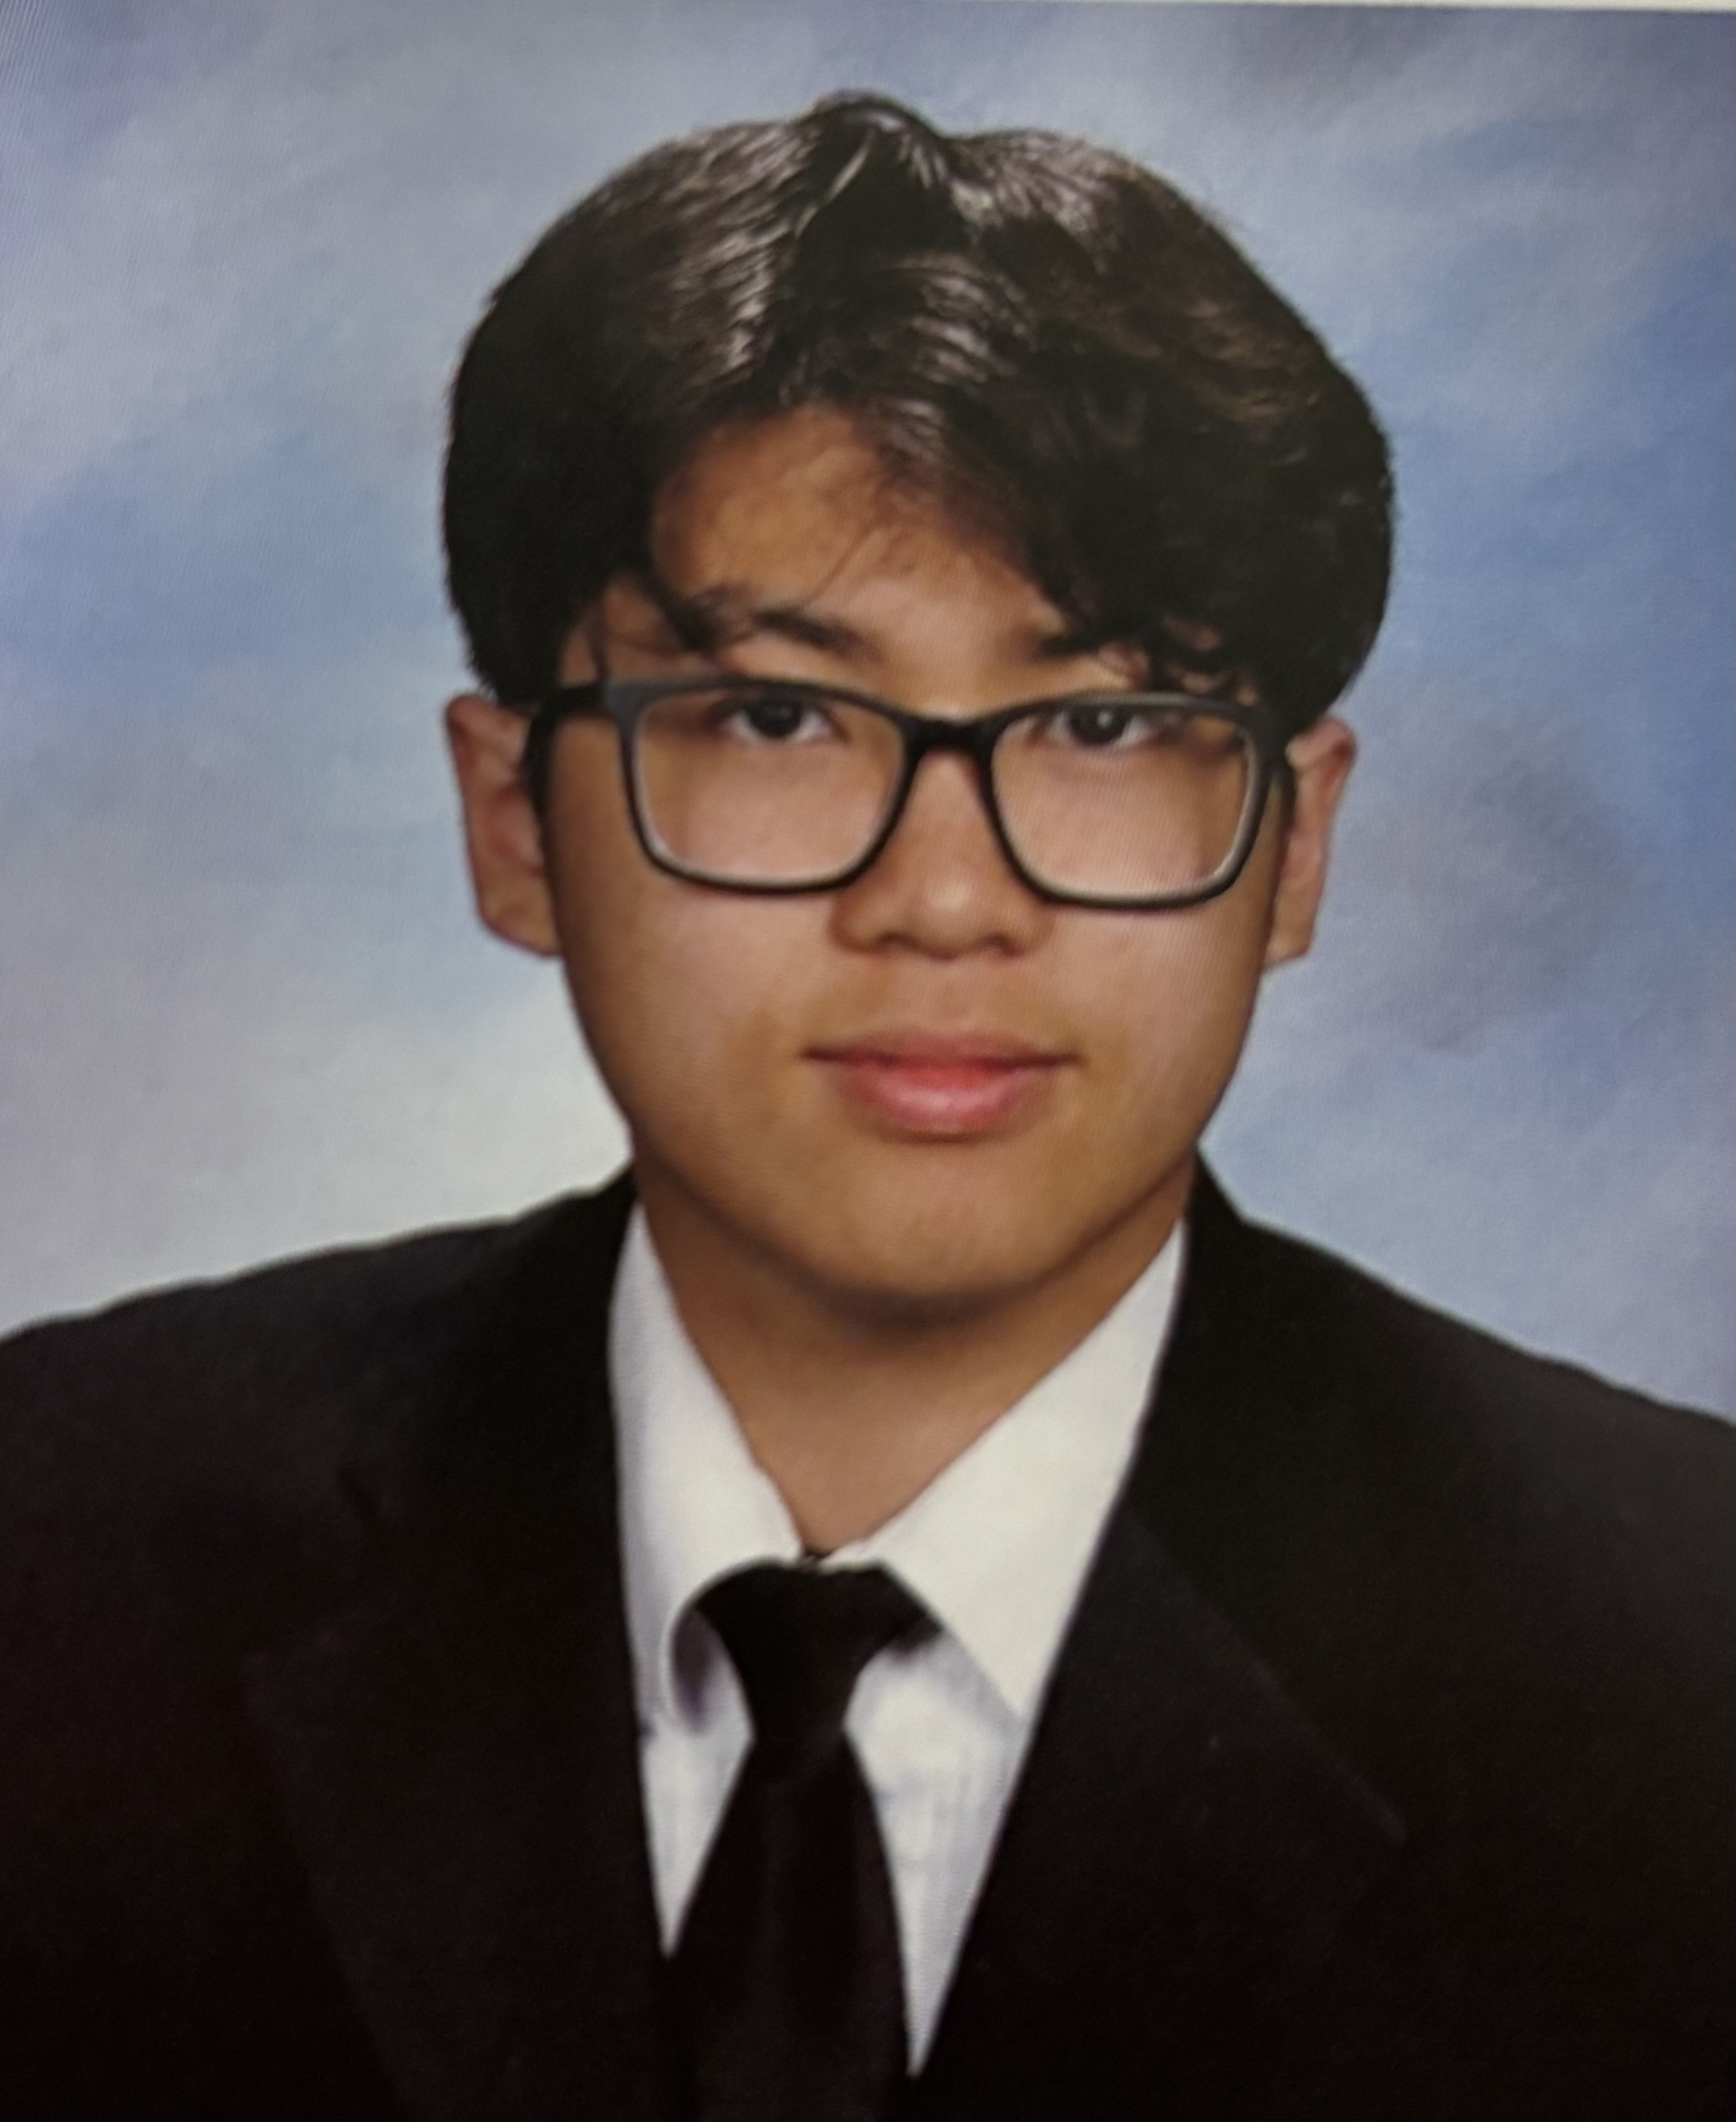
Introducing the Team!

Slide 4
Executive Summary
To create a Rutgers food delivery application that utilizes meal swipes to deliver on-campus takeout options to students
This provides convenience for Rutgers students
Will be entering the food delivery app industry, with direct competitors being DoorDash, Grubhub, and Uber Eats
Main goals are to achieve 15% brand recognition with the first year of operation, and 40% brand recognition within the first three years as well as $175,000 of sales revenue
This will succeed as such a large campus as Rutgers forces students to opt for delivery often - this simply allows for delivery using prepaid meal swipes
Centered and formulated particularly for Rutgers students

Slide 5
Situation Analysis
Need and Product Concept: Rutgers Students often struggle to use their meal swipes due to long distance to dining halls, limited time between classes, severe weather, and overall convenience issues. As a result, many prepaid meal swipes go unused each semester. Scarlet Delivery addresses this problem by offering a Rutgers-exclusive food delivery service that allows students to order from on-campus, meal-swipe eligible dining locations and are paid entirely through the student's meal plan, with only a standard 20% tip and a distance-based delivery fee.
Customer Need: Students need a faster, easier, and more affordable way to get on-campus meals without relying on costly outside delivery apps. They want dependable delivery handled by Rutgers-affiliated students and a way to fully use their meal plans instead of letting swipes go unused.
Service Solution: Scarlet Delivery meets these needs by letting students order on-campus meals using their Student ID and have them delivered to any residence on or near campus. The service remains affordable by using meal swipes instead of additional out-of-pocket costs, and Rutgers-affiliated delivery staff provide a smooth, safe, and efficient experience. This offers a convenient and reliable alternative to walking to dining halls or using outside apps.

Slide 6
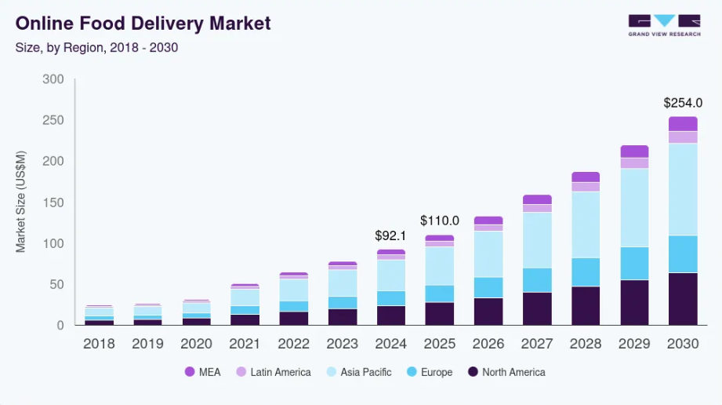
Industry Analysis
Entering the food delivery service industry
Trends
  Demand skyrocketed since COVID, will continue to rise
  Advanced tech -> easier orders
  Busy lifestyles and remote work -> online food delivery
  Younger demographics prefer digital methods over traditional dining or phone orders
Industry market size in 2024 = $288 billion USD*
Forecasted to exceed $500 billion USD by 2030*
CAGR of 9.4% from 2025 to 2030
Difficult entry
  Oligopoly
  Heavy rivalry
  Very strong brand images
  We offer unique value proposition
Shown is a chart of platform-to-consumer (Uber, DoorDash, Grubhub) data. The growth is still relative.
*These numbers are for the total market (all delivery methods combined).
The chart shown is one segment of the market but still accurately represents the projected growth.

Slide 7
Environmental Analysis
Strengths
Weaknesses
Convenience for students
Strong market (40,000 + students)
No competition that accepts meal swipes
Reliable staffing
Difficulty delivering by foot to dorms
Startup cost
Opportunities
Threats
Partnership with Rutgers or student organizations
Premium features like late night delivery, etc.
Easily replicable
Changes in weather
Technological issues
Difficulties with dining halls
Key Takeaways:
Students want convenience
Many students have extra meal swipes and look for different ways to use them
Differentiate from competitors because they do not accept meal swipes
Operational challenges
Challenge with size of Rutgers campuses
Need a seamless way to integrate Rutgers systems with delivery systems

Slide 8

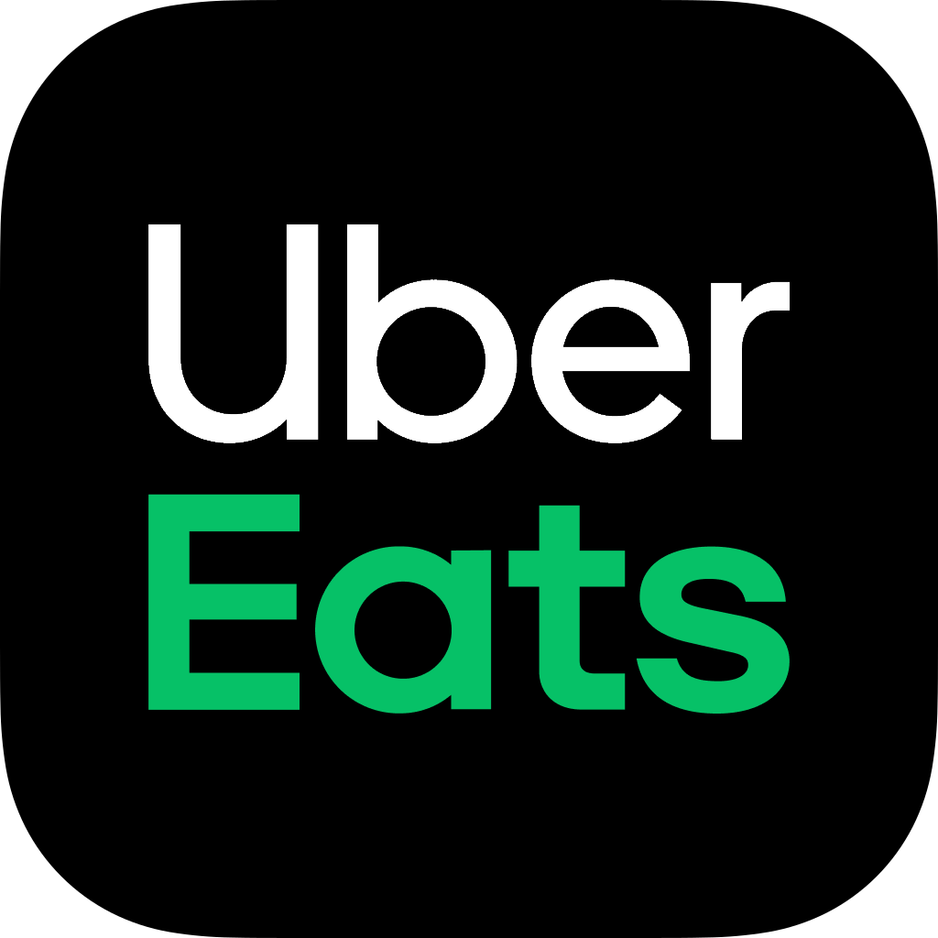
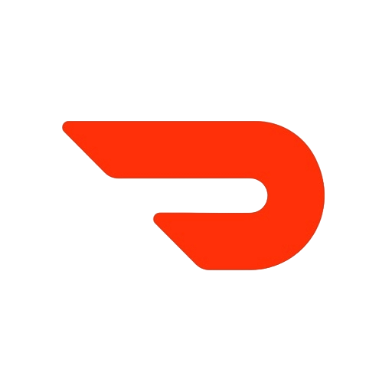
Direct Competitors:
Uber Eats / Door Dash / Grubhub
Large User bases, fast delivery options.
Wide restaurant variety.
Strong brand recognition.
But:
Do not accept meal swipes
Higher deliver fees + surge pricing (A period in which there is high demand, but low supply and prices are temporarily increased.)
Often slow on large campuses due to unfamiliarity with layout.
Competitive Analysis
Scarlet Delivery competitive advantages:
Exclusive ability to accept campus meal swipes (A unique value proposition).
Lower cost than outside delivery apps (No food markup; just tip + small fee).
Campus exclusive couriers → Faster deliveries and safer service.
Eliminates wasted meal swipes (Major point for students)
Designed specifically for Rutgers campus geography + dining system.
Competitive disadvantages / Challenges:
Integration required with Rutgers dining + payment options.
Delivery services limited to campus radius.
Dependent on recruiting reliable student couriers.
It is possible for competitors to imitate our model if the university allows it.
Indirect competitors:
Rutgers Dining hall (walk in only), uses meal swipes but has no delivery option.
Key takeaways:
No competitor currently accepts meal swipes, giving Scarlet delivery a strategic opening.
Convenience + cost savings are core differentiators.
Competitors struggle with high fees, slow delivery on campus, and no campus integration.
Scarlet delivery would be the only service built for Rutgers student needs.

Slide 9
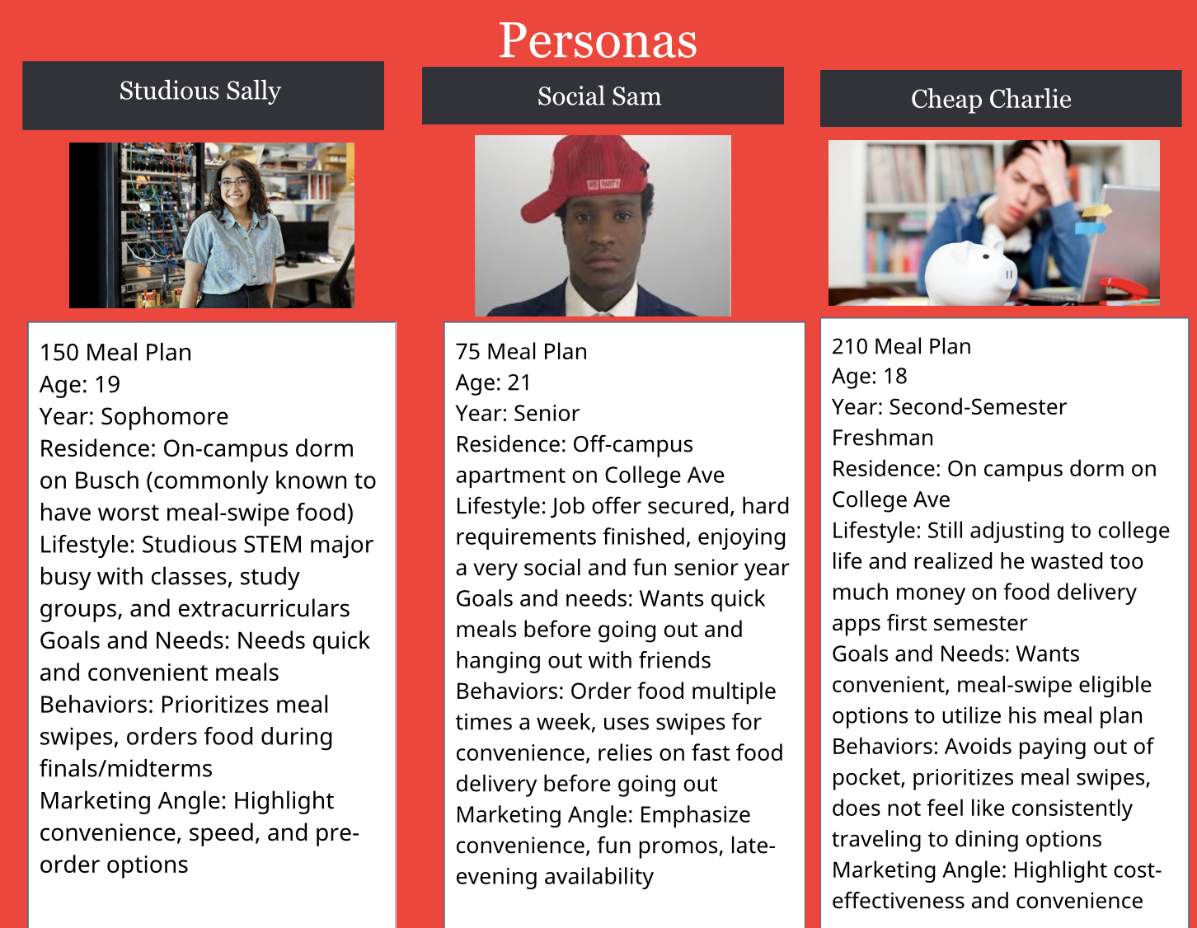
Target Audience
Demographics: Rutgers-New Brunswick students (primarily aged 18-22)
Geographic: Primarily students who live in on-campus housing or nearby off-campus student residences
Psychographic: Busy lifestyle, prioritize Convenience, tech-savvy, budget-aware, doesn't have a car on campus
Behavioral: Has a campus meal plan and opts for meal-swipe eligible locations, orders food multiple times a week especially during midterm and finals season

Slide 10
Achieve 15% brand recognition with the first year of operation, and 40% brand recognition within the first three years
Achieve 15% market share within the first two years
$175,000 annual sales revenue by the second year of operation
Increase our monthly sales revenue by 10% each semester for the first two years
Marketing Goals and Objectives

Slide 11
Marketing Strategy (Mix) - PRODUCT
Value Proposition: Scarlet Delivery allows students to use their prepaid meal plans for delivery, avoiding extra spending while preventing wasted swipes. Students use a meal swipe, add a 20% tip, and a small distance fee while campus-affiliated couriers ensure fast, reliable delivery while also creating flexible on-campus job opportunities.
USP: Students can use their university meal plan to pay for delivered meals, something that no other major delivery platform offers.
How do we differ?
  Payment with meal swipes
  Cheaper!
  Campus-focused: quicker delivery times and easier drop off to college dorms, apartments, and off-campus housing.
Customer experience:
  Seamless and convenient: As easy to use as the competitors
  Reliable and safe: University-vetted staff only
  Low cost: Students can use meal swipes that would other wise be wasted.
Aspects to draw customers and sustain loyalty:
  Campus branded (extensions of Rutgers), consistently affordable, and loyalty incentives.

Slide 12
Marketing Strategy (Mix) – PLACE
Scarlet Delivery uses a local, campus-focused distribution strategy.
Orders are placed online, through the app, and then delivered directly to the students’ dorms, apartments, or off-campus residences.
Why this method?
We chose the online and campus-focused local approach because we want to:
  Maximize convenience for students
  Leverage the delivery persons’ knowledge of the campus
  Integrate efficiently and seamlessly with the campus dining systems already in place.
Having a direct-to-consumer and app-based local model is the most efficient way to serve our Rutgers University customer base.

Slide 13

Pricing Strategy: Customer Value Based Pricing – Good Value
  Prices are set according to the perceived convenience and benefit to the students, rather than just the cost.
  Students will pay using a meal swipe, 20% gratuity, and a small service fee, which reflects the value of having their meal delivered to their desired location quickly, reliably, and safely.
Competitors Pricing:
  Uber-Eats: Uber Eats uses a dynamic, competition-based pricing.
  They consider factors such as demand, time, distance, competitor prices, with surge pricing applied during peak hours, causing prices to rise.
  This, in addition to a tip and a delivery fee, causes prices to be much higher than the actual cost of food; presenting the need for Scarlet Delivery
Promotions/Seasonal Pricing:
  Scarlet Delivery will have a multitude of promotions/seasonal pricing to offer to students, such as:
    Reduced prices and deals during mid-terms and finals
    Special holiday and semester kickoff promotions
    End of semester specials to ensure use of leftover swipes
    Freshman/first year transfer student welcome offers to encourage app use
Marketing Strategy (Mix)
PRICING

Slide 14

Marketing Strategy (Mix) –
PROMOTION
Advertising: Targeted social media ads (at Rutgers students), flyers around campus and residence halls, ads on busses, and posters/displays at each dining hall.
Public Relations: Collaborate to have consistent shoutouts/ads from the Daily Targum (newspaper), WRSU 88.7 FM (radio), and email blasts to gain credibility with students
Content Marketing: Will heavily focus on social media, as that is where college students are most accessible. Specific deals, promotions, and specials will be given out on social media, along with meal plan hacks, dining hall reviews, and key updates
Social Media Strategy / Influencer Partnerships: Scarlet Delivery will have a presence on most social medias popular with students: Instagram, TikTok, Snapchat.
  Engaging posts, videos, shorts/reels, will be made to draw attention.
  Influencers: Athletes, professors, and current social media stars will be brought into help the social media team create content and gain popularity with the students.
Why? – All of these choices are campus focused, driven to students, and will build trust, popularity, and drive app use.

Slide 15

Plan: Ensure the application's stability and technical performance through constant monitoring while gaining feedback through the app or university-wide efforts to work upon said issues to ensure an efficient and smooth process
KPIs: Impressions, Conversion Rate, Churn Rate, Daily Active Users, Meal Swipe Usage Rate, Average Delivery Time, Driver Availability, Net Promoter Score, Sales
Timeframe of Review: This will be a constant process at the beginning to catch any bumps along the way. At the very least, once a week, through metrics data from the app and feedback. Once determined we have hit a maturity stage, once every three months.
On Target: Continue to set objectives and goals that fit the scope of our potential with continuous improvement from the voice of our customers and hope to implement across universities nationwide.
Off Target: Begin to analyze where the plan is failing and aim to solve these root causes while remaining transparent with customers. If still in a downward trend, begin to re-evaluate/redesign or determine if the app is still feasible or have talks of terminating the service.
Evaluation & Control

Slide 16
Works Cited
https://www.grandviewresearch.com/industry-analysis/online-food-delivery-market-report#:~:text=Delivery%20Industry%20Trends-,The%20online%20food%20delivery%20market%20in%20the%20U.S.%20is%20expected,scope%20beyond%20traditional%20restaurant%20meals
https://www.statista.com/outlook/emo/online-food-delivery/united-states
https://pmc.ncbi.nlm.nih.gov/articles/PMC10163566/
https://ag.purdue.edu/news/2024/10/consumer-food-insights-report-highlights-increasing-use-of-food-ordering-apps.html

